Slide 1
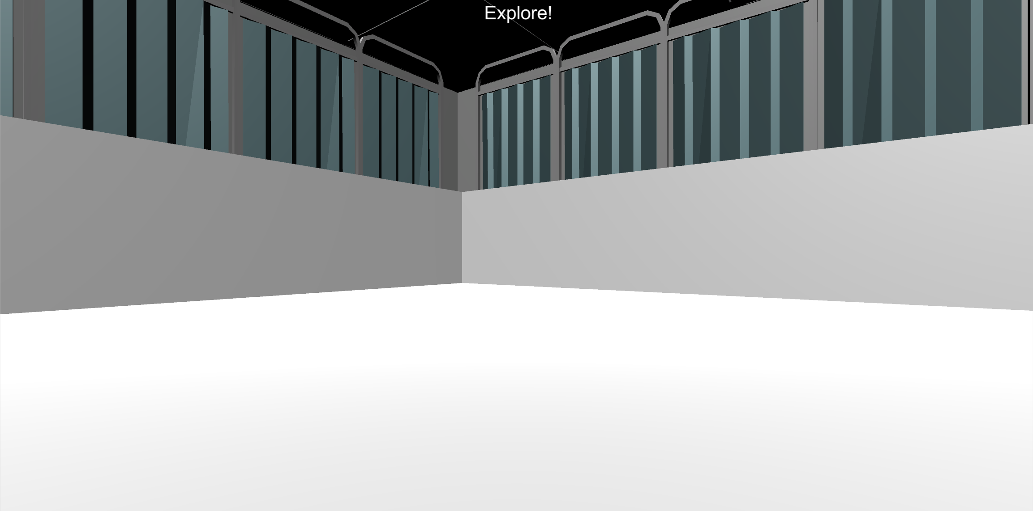
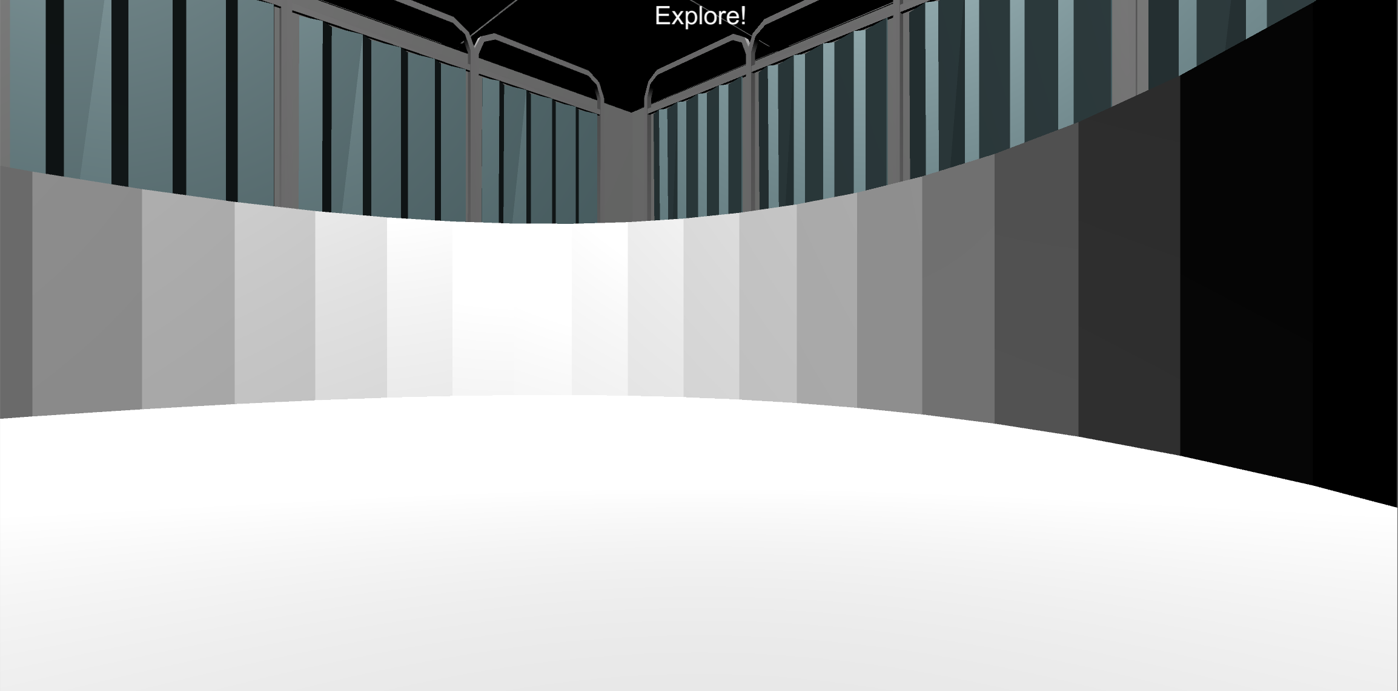
Welcome!
1
In this first section, your job is to find as much money as possible in the environments that you’ve learned over the course of this experiment.
Search For Money
Search For Money

Slide 2
Welcome!
2
In this first section, your job is to find as much money as possible in the environments that you’ve learned over the course of this experiment.
Search For Money
Search For Money

Slide 3
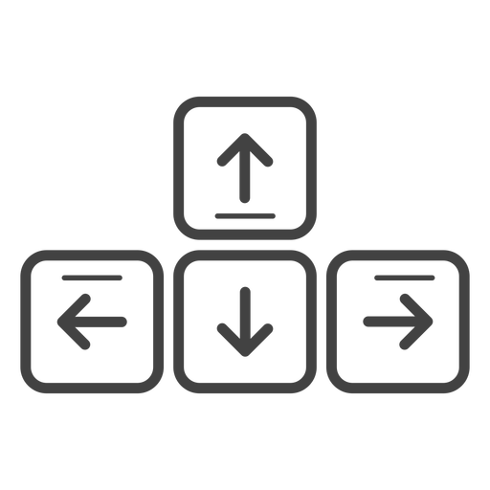
MOVEMENT CONTROLS
The controls are the same as previous sessions: use the Up-Arrow to move forward, and the left and right arrow-keys to rotate.
Move Forward
Rotate
Left
Rotate
Right

Slide 4
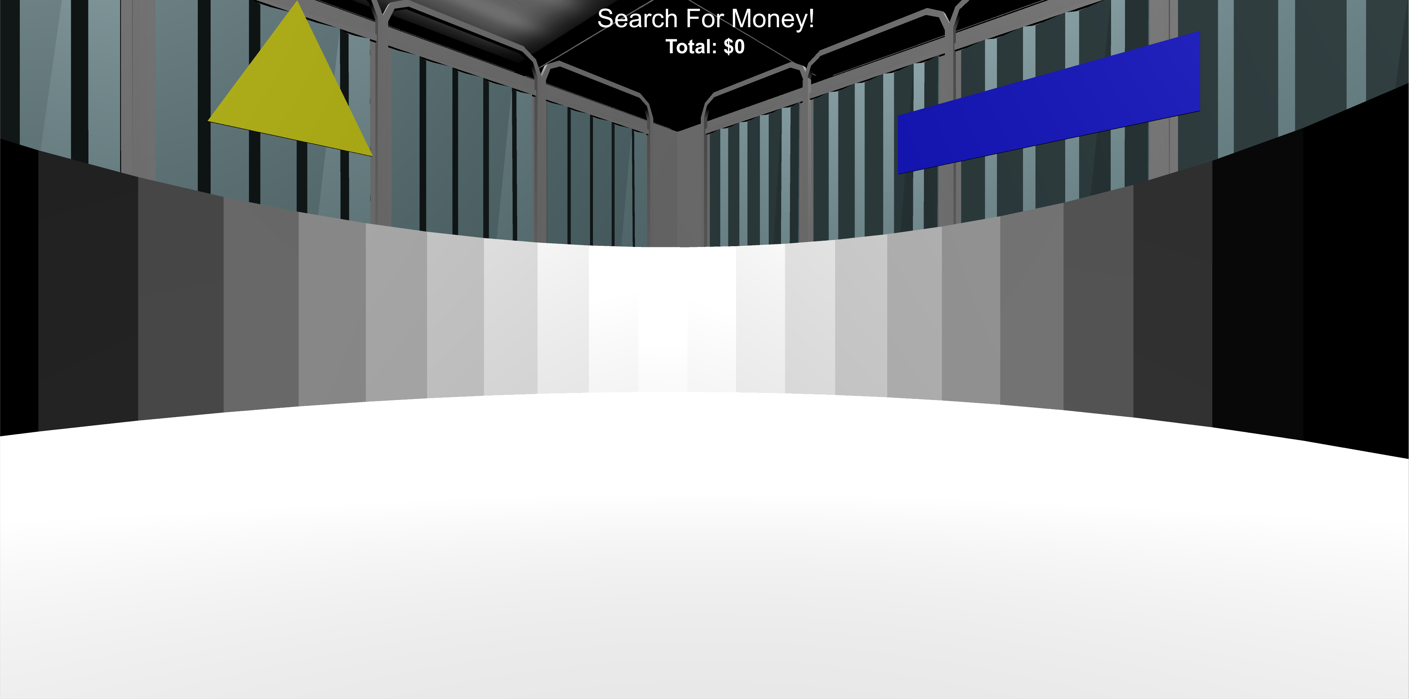

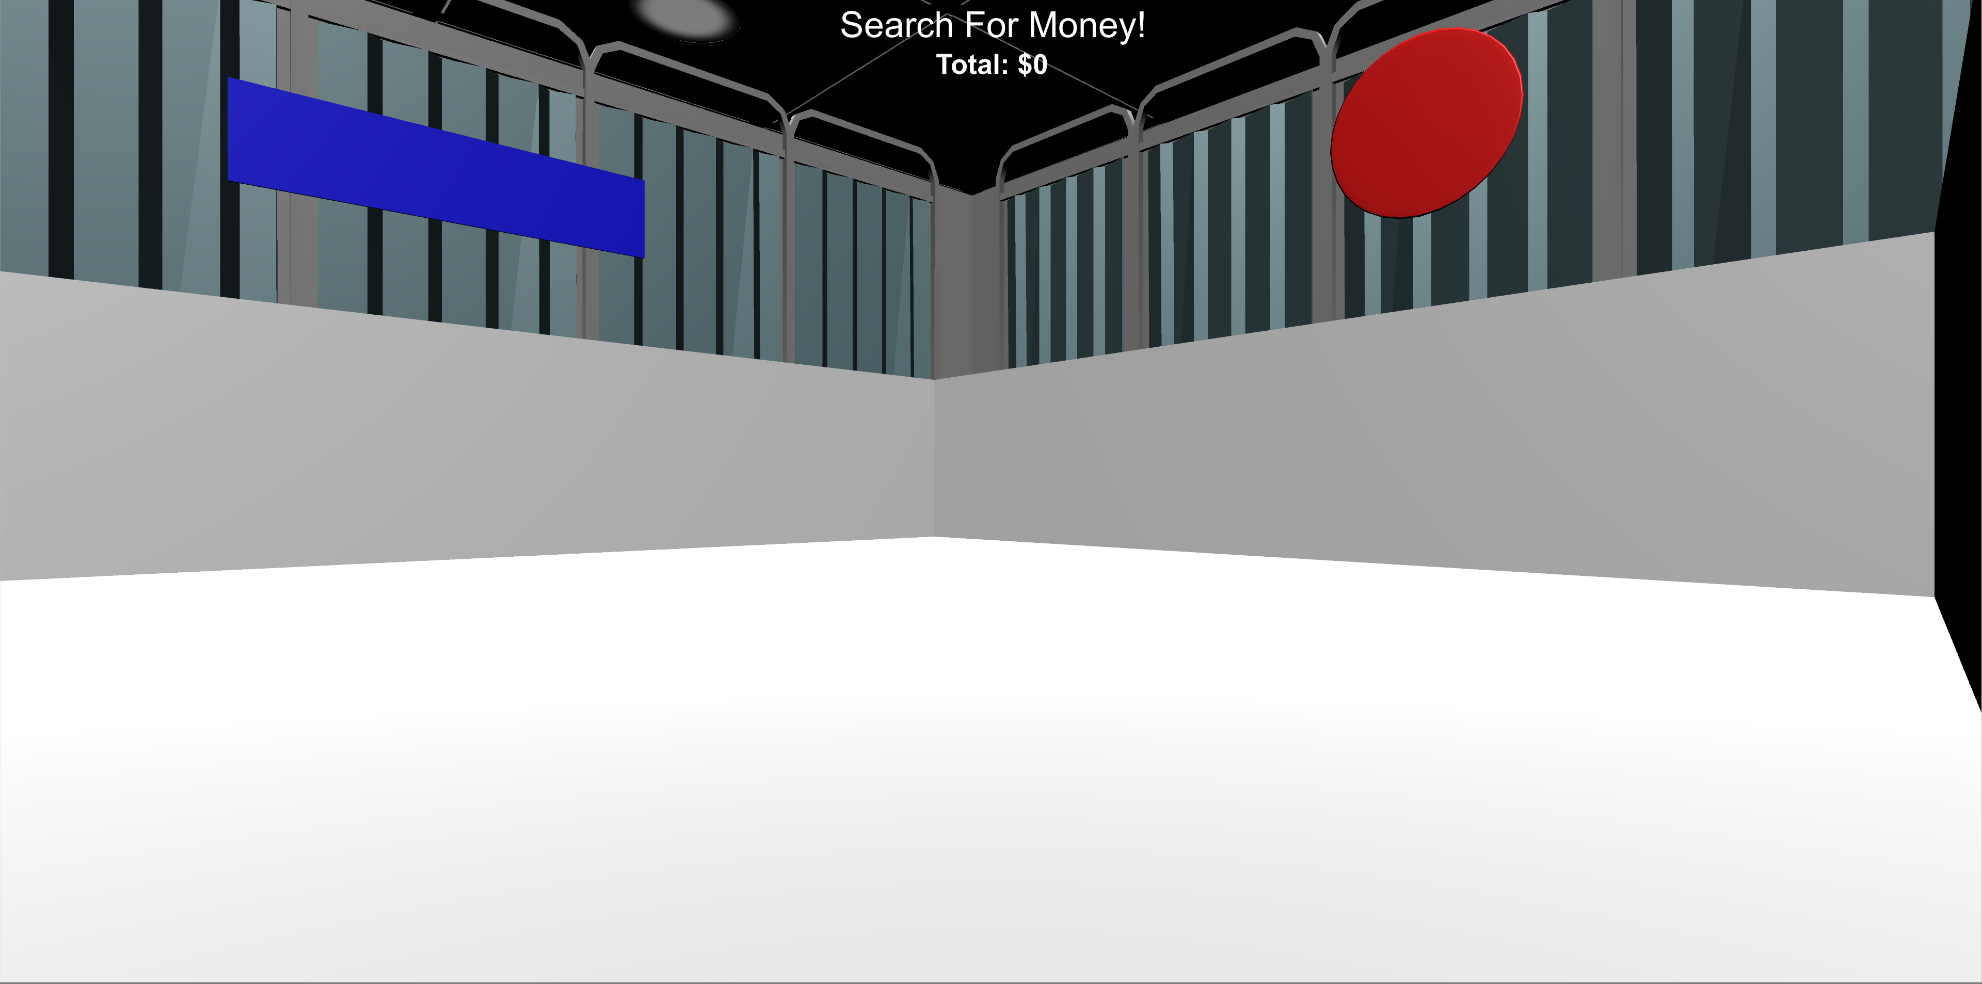
MONEY COLLECTION ROUNDS
In this session, all Money Collection Rounds are No Feedback Rounds:
no sound and no collection total!
you will see the “Search For Money! NO FEEDBACK” screen before being placed into the environment. Once in the environment you will have 1 minute to collect as much money as possible! You won't find out how much you’ve collected until the end of this session!

Slide 5

BONUS PAYMENT
There is an UNLIMITED amount of money to collect in each round and any money you collect you will receive as a BONUS PAYMENT at the end of the experiment!

Slide 6
HINT!!
Use what you’ve learned from previous sessions to guide your search!

Slide 7
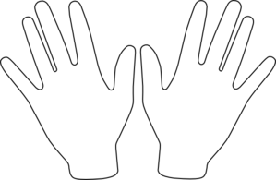
Do you have any questions about this portion of the experiment? The experimenter will now leave the room and let you continue on your own. When this portion of the experiment is over you will be asked to notify the experimenter.
Spacebar
Place your right hand on the arrow keys and press the Spacebar with your left to continue!

Slide 8
Great Work! Please notify the experimenter that you have completed this portion of the experiment.

Slide 9
VARIATION COLLECTION ROUNDS
In this next section of the experiment you will be placed in several variations of the environments that you have learned.
Again, you won’t receive any feedback when you collect money, so you will have to use what you learned in previous sessions to guide your search!
You will receive a bonus payment equal to the amount that you collect, but you won’t find out how much you’ve collected until the end of the experiment!
Good Luck!!

Slide 10
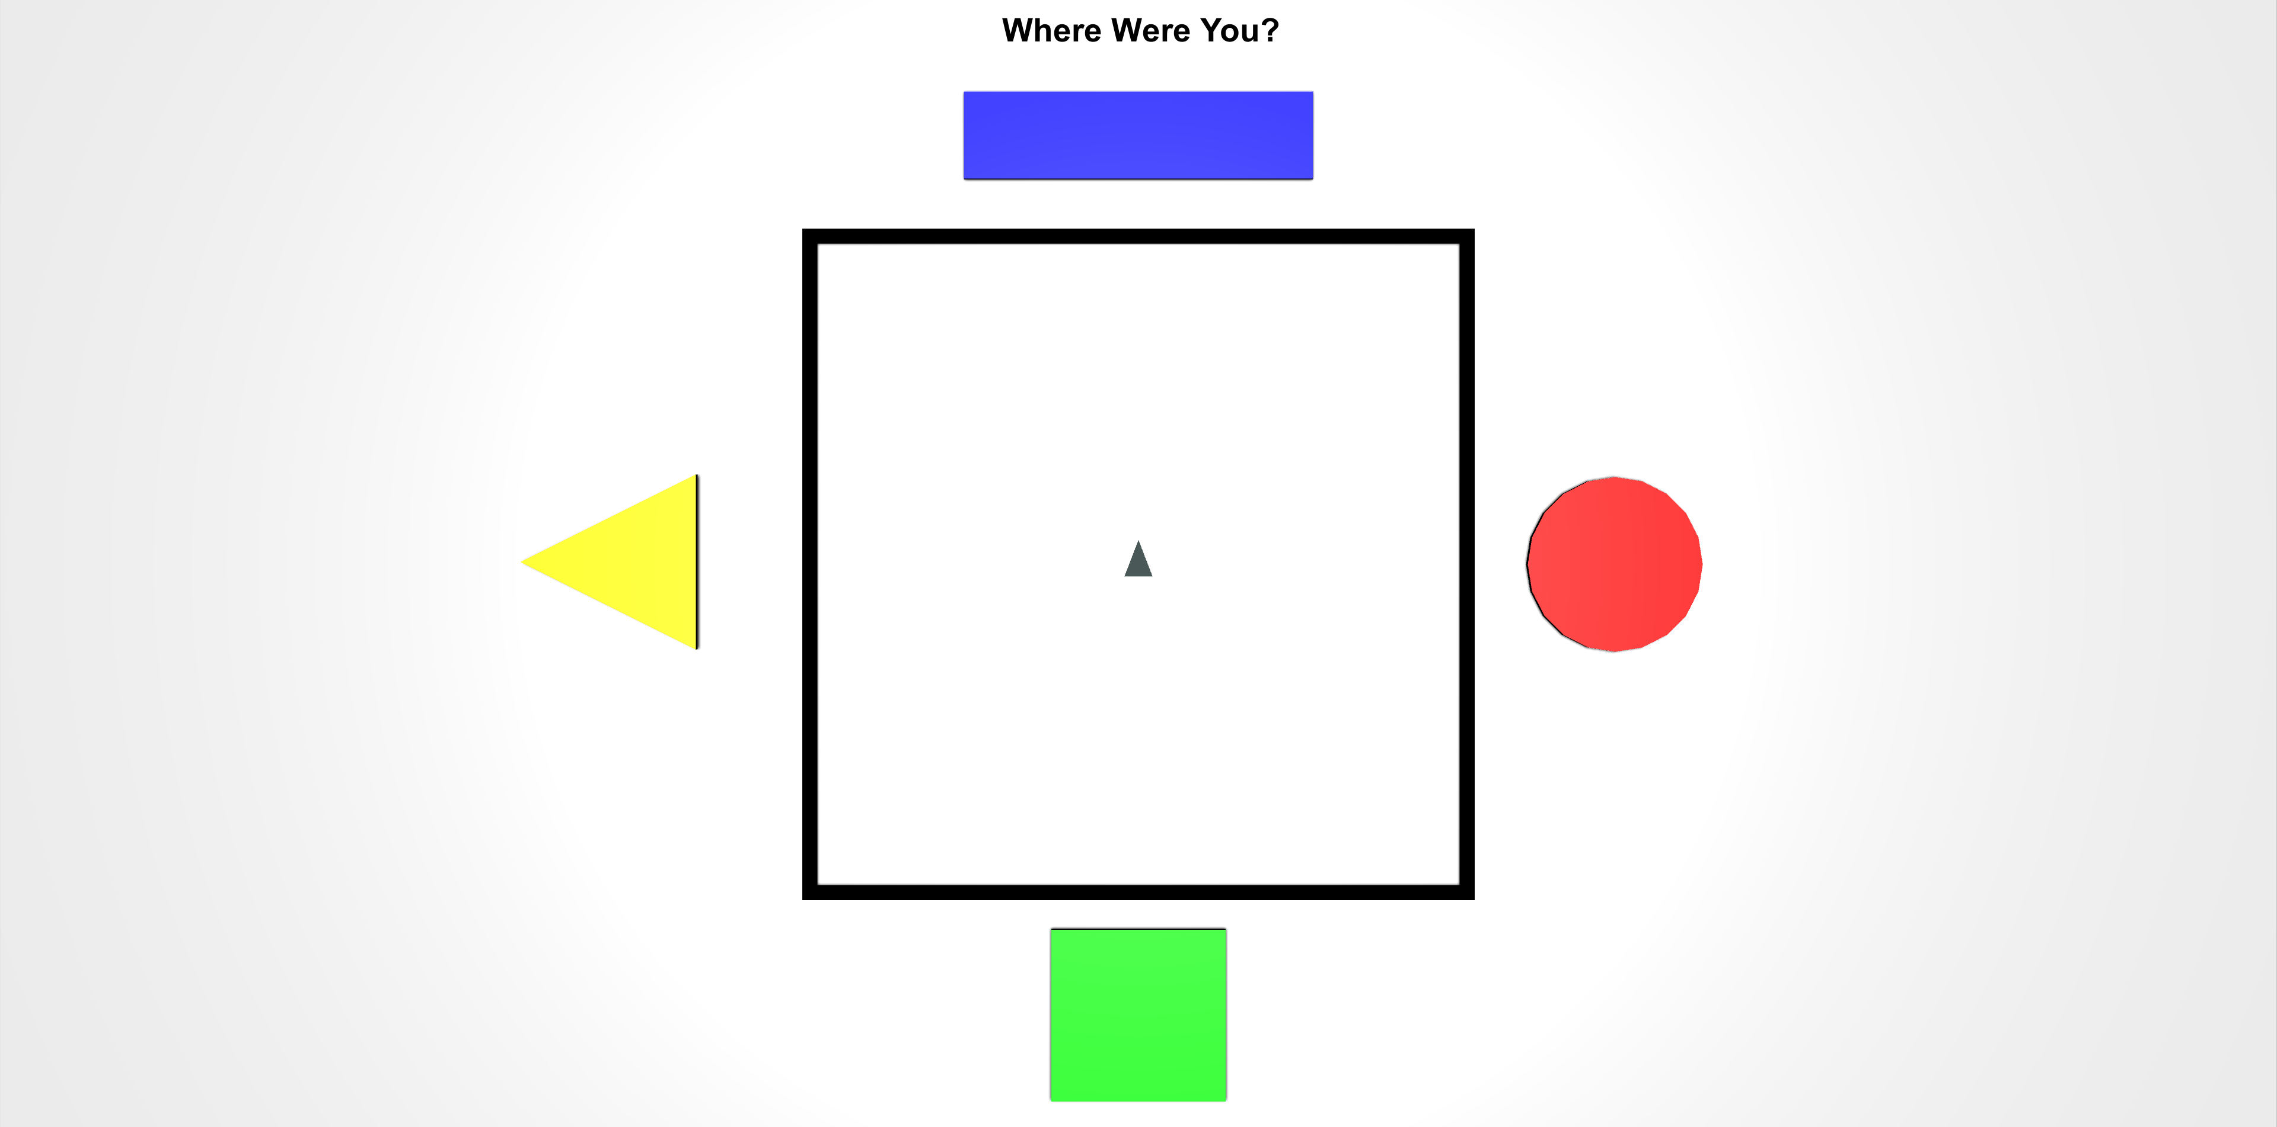
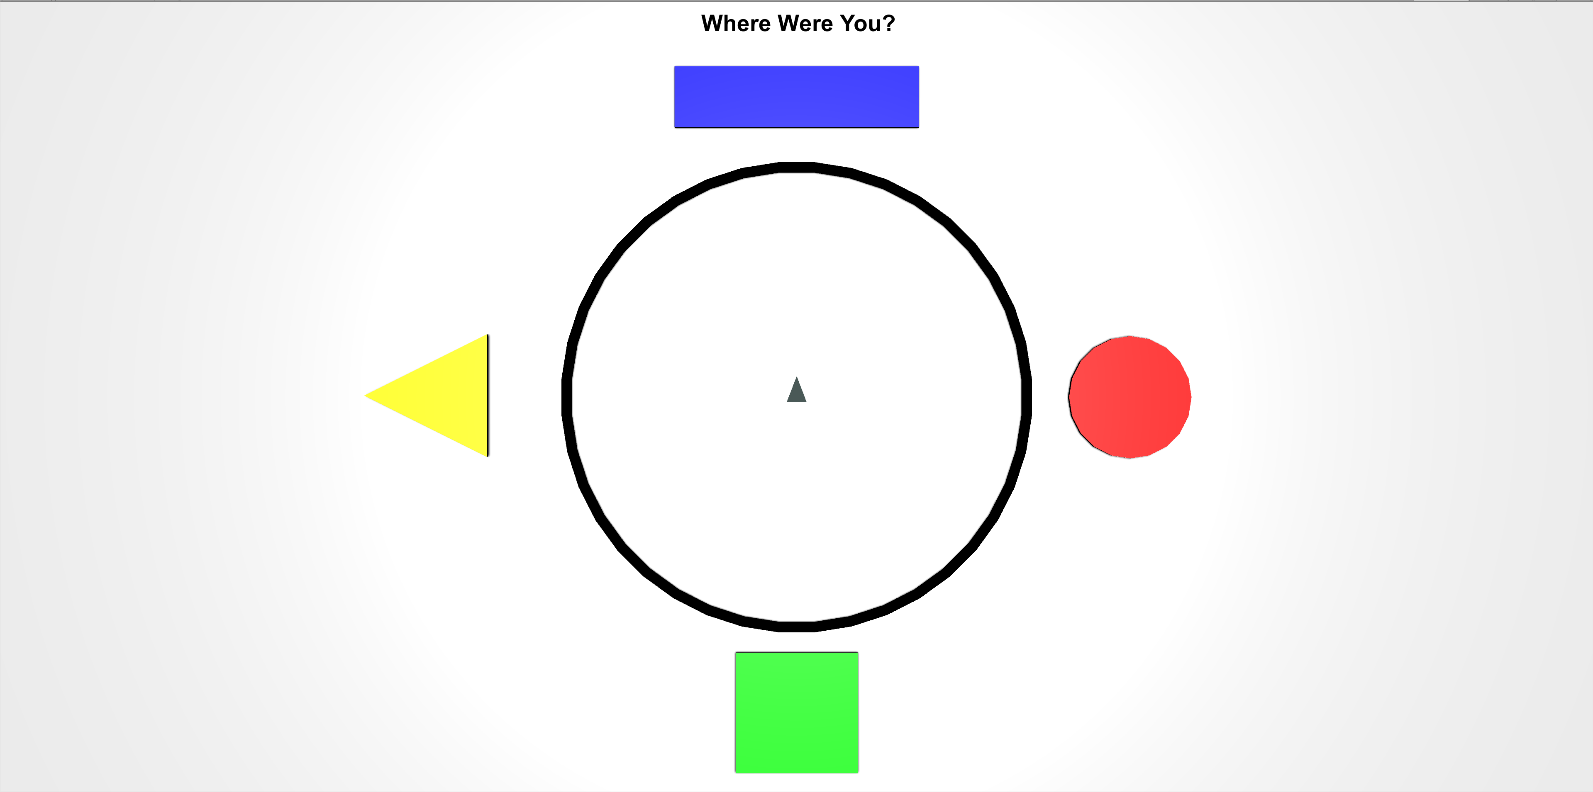
While refamiliarizing yourself with the environments, you will be asked periodically to locate your position from a top-down viewpoint like the ones pictured below.
The grey triangle in the middle shows the direction that you’re facing, and the controls are the same as the 3D environment. Move the grey triangle to the last position you were in, in the 3D environment and then press the Spacebar.

